Slide 1
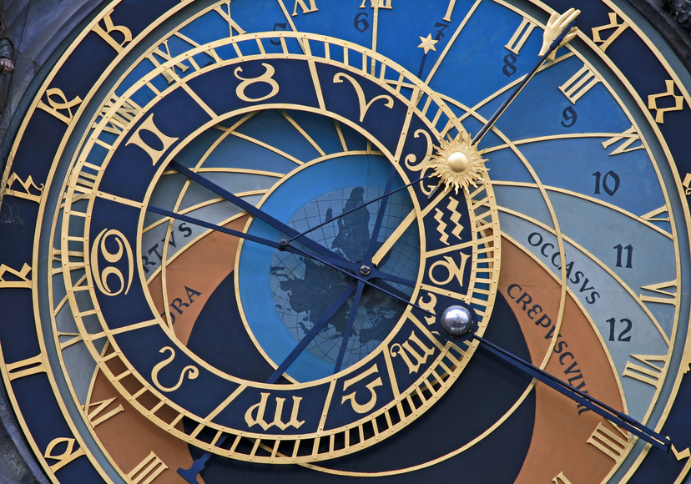
Quelle heure est – il ?
What time is it?

Slide 2
Quelle heure est –il?
Telling the time in French is simple as long as you follow the basic rules.
Always remember:
Hours first, minutes last.

Slide 3
For telling the hour
Il est une heure =
It’s one ‘o’ clock
Il est cinq heures =
It’s five ‘o’ clock
Il est midi =
It’s midday
Il est minuit =
It’s midnight

Slide 4
For telling the half hour
Now we need to learn a new word:
demie = half
Il est deux heures et demie = It’s half past two.
Il est quatre heures et demie = It’s half past four.

Slide 5
For telling the quarter hour
Here is the tricky part. We need two new words:
quart = quarter
moins = less
Il est trois heures et quart = It’s quarter past three
Il est trois heures moins quart = It’s quarter to three

Slide 6
All other times
For all other times simply make sure you follow the rule: Hours first, minutes last.
Il est quatre heures cinq = It is 4.05
Il est six heures moins cinq = It is 5.40
Il est sept heures vingt trois = I’s 7.23

Slide 7
Your turn!
Translate the following times:
Answers:
Il est sept heures et demie.
Il est huit heures et quart.
Il est onze heures moins quart.
Il est trois heures vingt.
Il est neuf heures moins dix.
It’s half past seven (7.30)
It’s quarter past eight (8.15)
It’s quarter to eleven (10.45)
It’s twenty past three (3.20)
It’s ten to nine (8.50)

Slide 8
24 hour time
In France, radio stations, TV guides, train timetables, in fact everyone uses 24 hour time.
This means that after midday, you add twelve hours to the time before you say it in French.
Il est quatorze heures et quart = It’s quarter past two in the afternoon (2.15pm)

